Slide 1
NERVOUS PHYSIOLOGY

Slide 2
UNIT 1

Slide 3
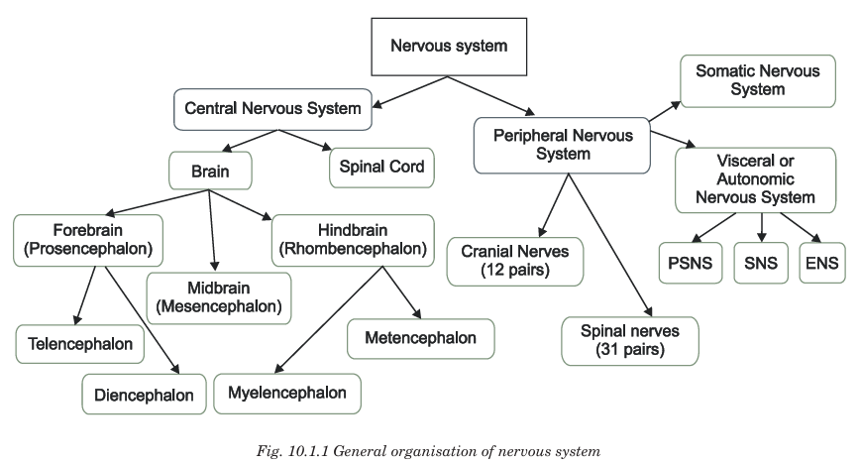

Slide 4
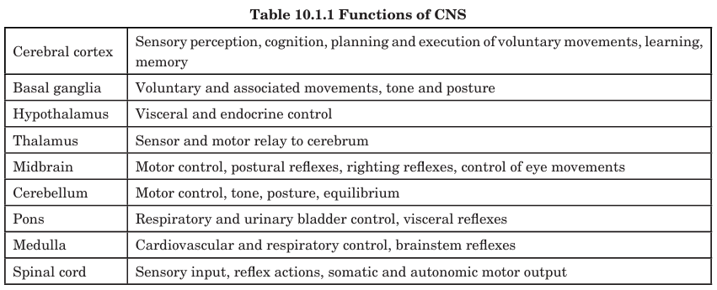

Slide 5
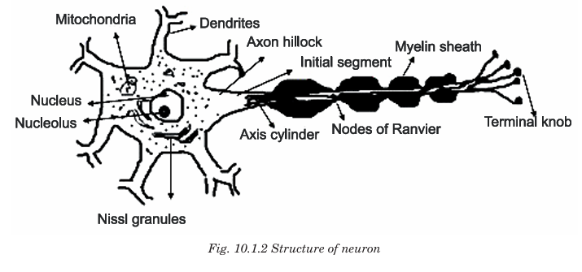

Slide 6
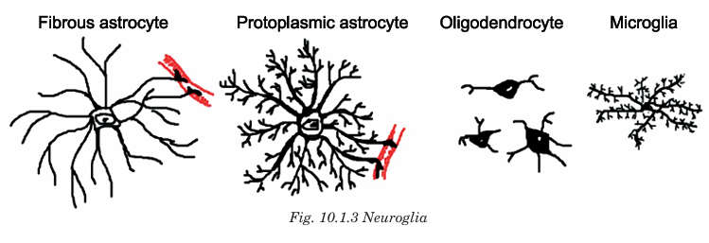

Slide 7
UNIT 2

Slide 8
NERVES
Nerves are bundles of axons (nerve fibers) enclosed in connective tissue that transmit impulses between the central nervous system (CNS) and various body parts.
Type | Origin | Function
Cranial nerves (12 pairs) | Brain | Sensory, motor or mixed
Spinal nerves (31 pairs) | Spinal cord | All mixed (sensory + motor)

Slide 9
FUNCTIONAL CLASSIFICATION
Type | Function | Example
Sensory (Afferent) | Carry impulses to CNS | Optic nerve
Motor (Efferent) | Carry impulses from CNS to muscles/glands | Hypoglossal
Mixed | Both sensory + motor fibers | Spinal nerves

Slide 10
PARTS OF PERIPHERAL NEURON
Layer | Covers
Endoneurium | Individual axon
Perineurium | Fascicle (bundle of fibers)
Epineurium | Whole nerve

Slide 11
NERVE INJURY
Causes
Trauma
Compression
Stretching
Ischemia
Inflammation
Toxins / metabolic disorders (e.g., diabetes)

Slide 12
TYPES OF NERVE INJURY
Type | Site of damage | Recovery | Examples
Neuropraxia | Conduction block without axonal damage | Full recovery in days–weeks | Saturday night palsy
Axonotmesis | Axonal damage, sheath intact | Regeneration possible | Crush injury
Neurotmesis | Complete transection of nerve | No spontaneous recovery (needs surgery) | Knife injury

Slide 13
UNIT 3

Slide 14
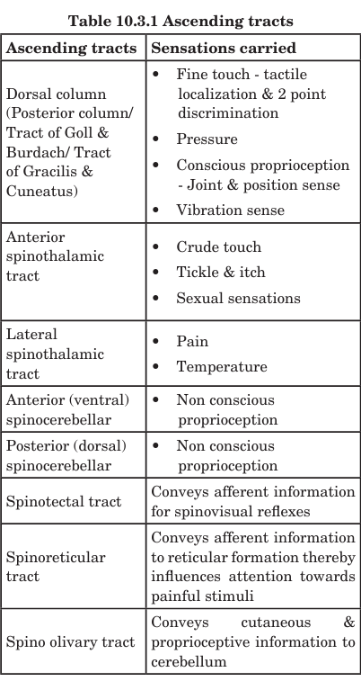

Slide 15
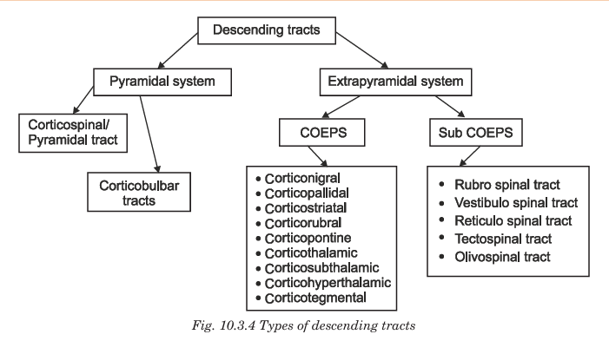

Slide 16
UNIT 4

Slide 17
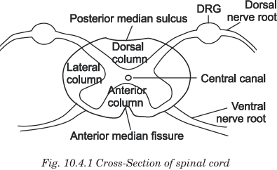

Slide 18
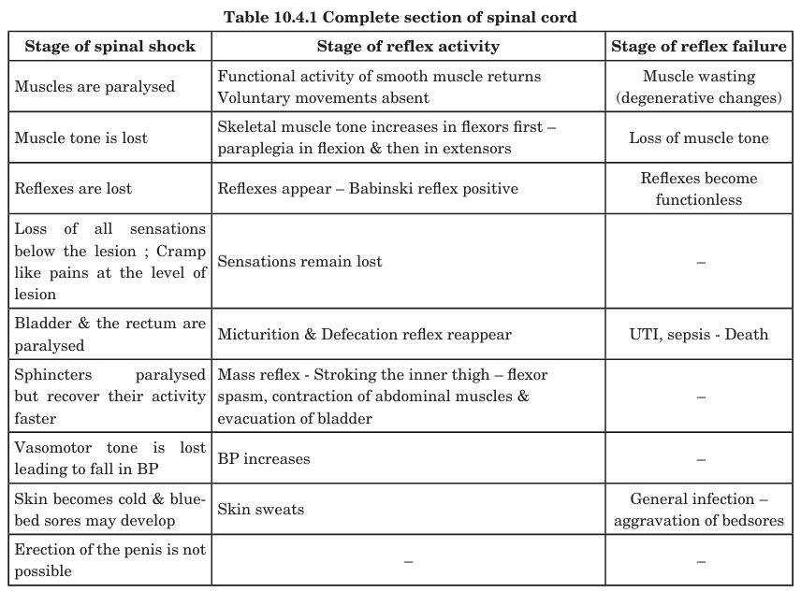

Slide 19
UNIT 5

Slide 20
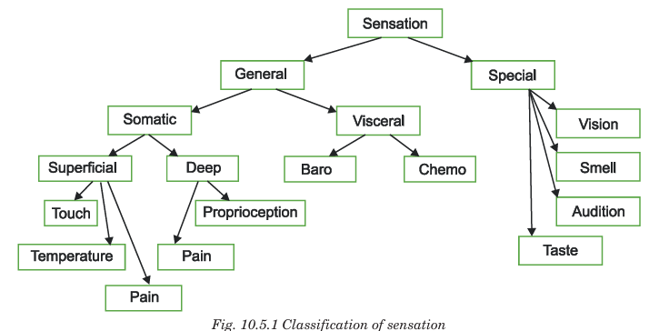

Slide 21
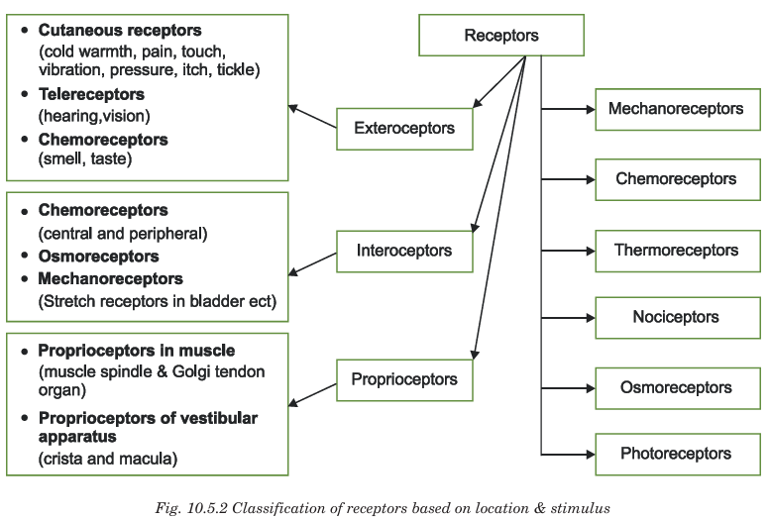

Slide 22
UNIT 6

Slide 23
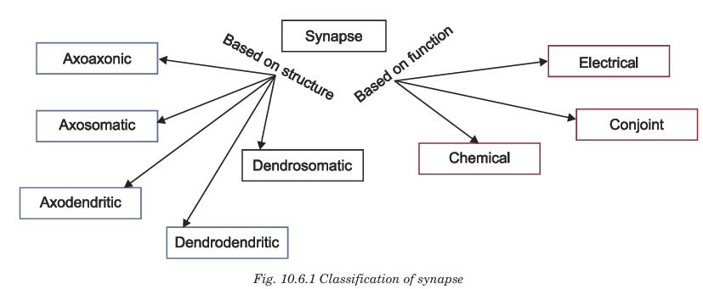

Slide 24
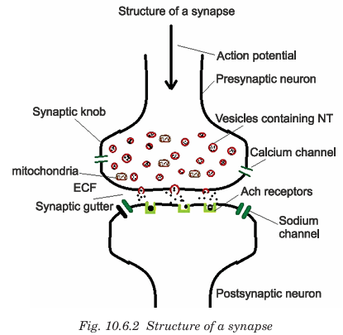

Slide 25
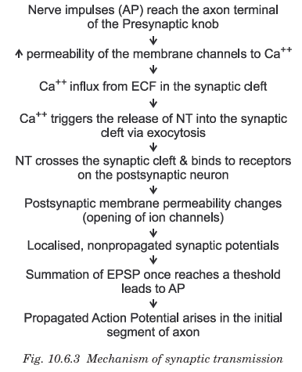

Slide 26
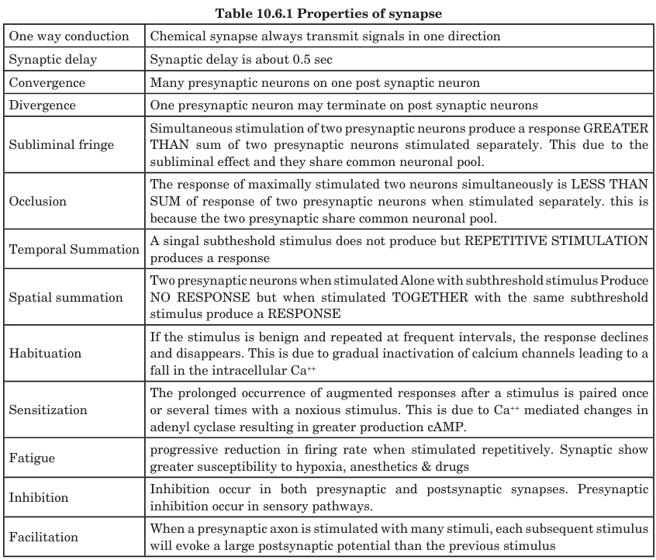

Slide 27
UNIT 7

Slide 28
MUSCLE TONE
Muscle tone (tonus) is the constant, involuntary, partial contraction of skeletal muscles that maintains firmness and readiness for action even when the muscle is at rest.
It is not strong enough to produce movement, but sufficient to maintain posture.

Slide 29
APPLIED ASPECTS
Hypotonia (decreased tone) occurs in lower motor neuron paralysis and in cerebellar lesion. Hypertonia (increased tone) occurs in upper motor neuron paralysis. Hyperactive stretch reflexes can lead to tremors and clonus. Clonus is elicited by a sustained stretch of a muscle in a person who has spinal cord damage. The conduction delay between the initiating stimulus (muscle stretch) and the response (muscle contraction)in such cases can cause it to be a source of instability resulting in rhythmic movements such as tremors and clonus.

Slide 30
UNIT 8

Slide 31
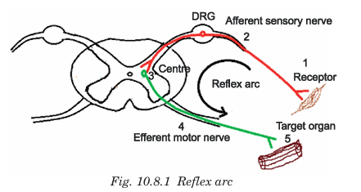

Slide 32
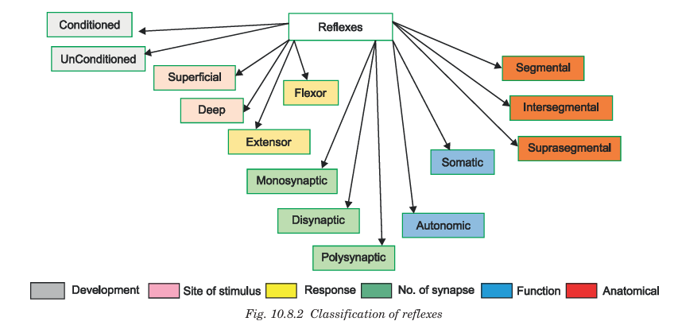

Slide 33
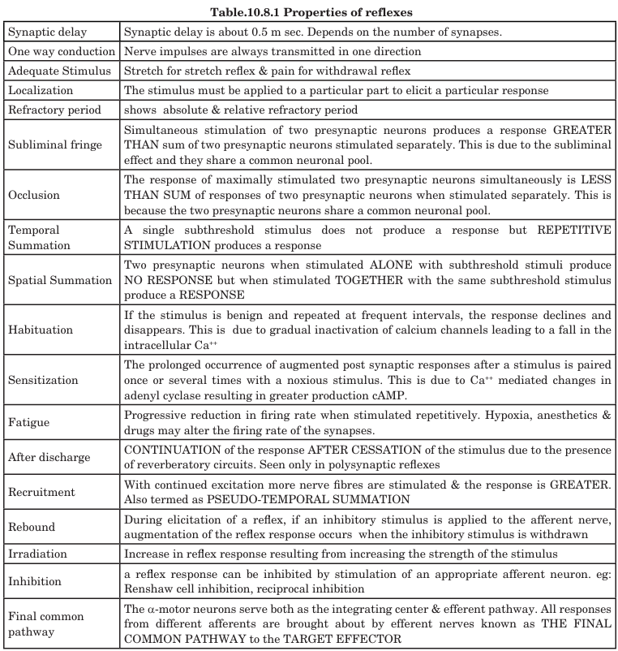

Slide 34
UNIT 9

Slide 35
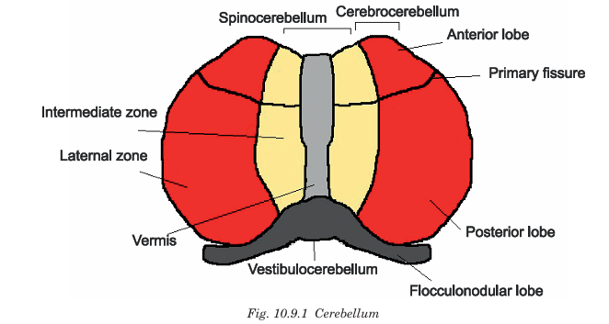

Slide 36
CEREBELLAR LESIONS FEATURES
Loss of cerebellum can cause almost total incoordination of motor activities in the same side even though its loss causes paralysis of no muscles. Ataxia – lack of coordination of movements; Dysmetria / past pointing - movements ordinarily overshoot their intended mark; Intention tremor – tremor while doing a voluntary motor act; Nystagmus – to and fro movement of the eyeballs that occur usually when one attempts to fix the eyes on a scene; Dysarthria – scanning speech with jumbled vocalisation; Drunken or reeling gait - wide-based, unsteady gait; hypotonia – decreased muscle tone; Rebound phenomenon – failure to brake the movement of the limb; Adiadochokinesia, the inability to perform rapidly alternating opposite movements such as repeated pronation and supination of the hands; Decomposition of movement - difficulty performing actions that involve simultaneous movement at more than one joint

Slide 37
UNIT 10

Slide 38
BASAL GANGLIA
Basal Ganglia are a group of subcortical (deep) nuclei of the forebrain involved in the control of movement, posture, muscle tone, and behavior.
They do NOT initiate movement, but regulate and refine it.

Slide 39
APPLIED ASPECTS
Disease | Pathology | Features
Parkinson’s disease | ↓ Dopamine due to degeneration of substantia nigra | Resting tremor, rigidity, bradykinesia, hypokinesia
Huntington’s disease | Degeneration of striatum (caudate) | Chorea (jerky movements), dementia
Hemiballismus | Lesion of subthalamic nucleus | Violent flinging movements
Wilson’s disease | Copper deposition in basal ganglia | Dystonia, behavioral change, tremor
Dystonia | Abnormal tone due to BG dysfunction | Twisting movements

Slide 40
UNIT 11

Slide 41
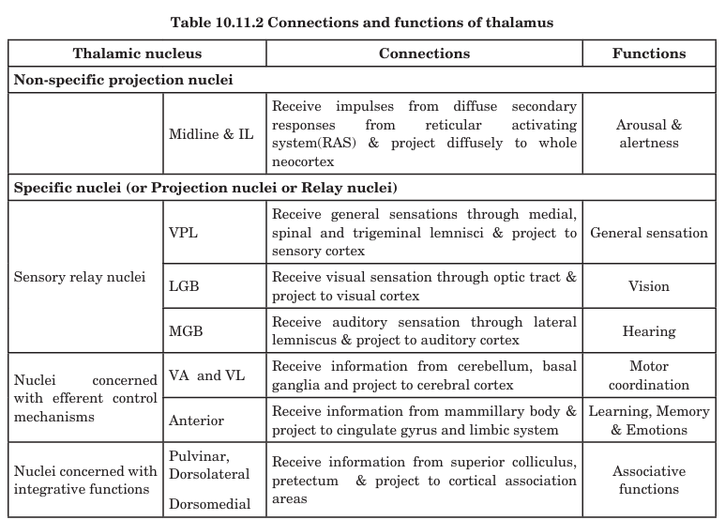

Slide 42
UNIT 12

Slide 43
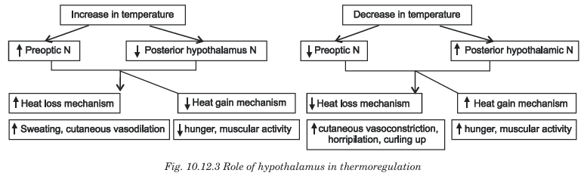

Slide 44
UNIT 13

Slide 45
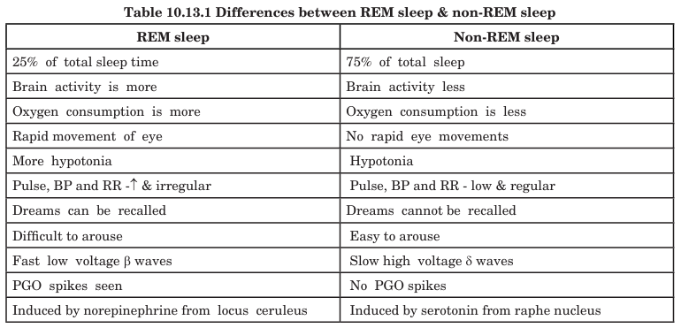

Slide 46
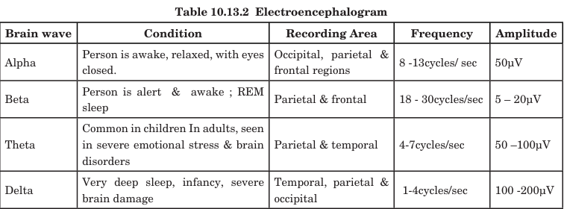

Slide 47
UNIT 14

Slide 48
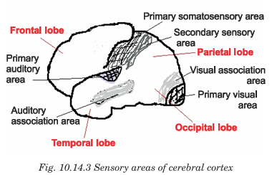

Slide 49
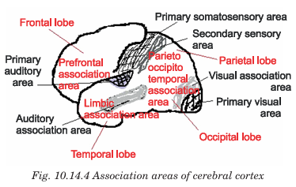

Slide 50
UNIT 15

Slide 51
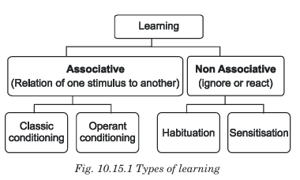

Slide 52
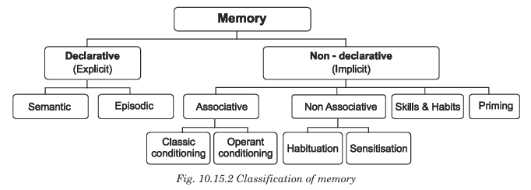

Slide 53
Functions of limbic system are
(i) Perception of smell
(ii) Control of emotions and behavior
(iii) Reward and punishment (iv) Learning
(v) Memory
(vi) Sexual behavior (Preservation of species)
(vii) Feeding behavior (Preservation of self)
(viii) Emotional exteriorization and
(ix) Maternal behavior.

Slide 54
UNIT 16

Slide 55
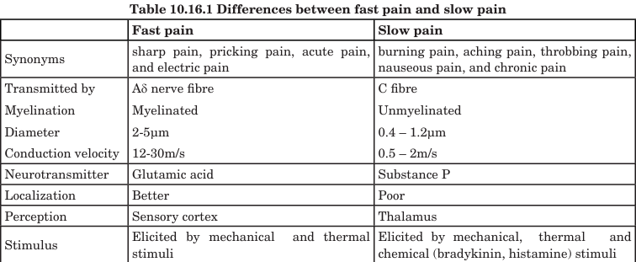

Slide 56
APPLIED ASPECTS
Stress analgesia is seen in soldiers wounded in the war front wherein they do not feel the pain.
Hyperalgesia is a condition in which pain is produced by non-noxious stimuli [eg: touch]. It can occur either due to tissue damage or nerve damage.
Causalgia is persistent burning pain following nerve injury. It is accompanied by sweating and vasomotor changes. Pain inhibiting opioids act at the level of the gate.

Slide 57
UNIT 17

Slide 58
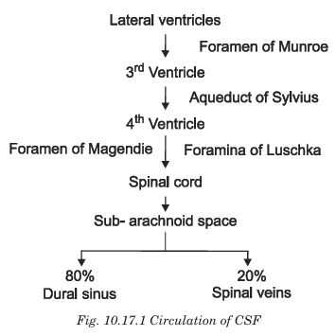

Slide 59
Function Category | Explanation
1️⃣ Mechanical Protection | Acts as a cushion and shock absorber, protects brain and spinal cord from trauma and sudden movements.
2️⃣ Buoyancy | Makes the brain float and reduces its effective weight from 1500 g to 50 g → prevents brain from crushing its own structures.
3️⃣ Chemical Stability | Maintains optimal ionic environment for neuronal function → regulates pH and electrolyte balance.
4️⃣ Nutrient Transport | Helps supply glucose, oxygen, vitamins and other nutrients to CNS tissues.
5️⃣ Waste Removal | Removes metabolic by-products and toxins (e.g., CO₂, lactate) from CNS → excreted via venous system.
6️⃣ Circulation of Biomolecules | Transports hormones, neurotransmitters and neuropeptides within CNS.
7️⃣ Maintenance of Intracranial Pressure (ICP) | Helps maintain constant intracranial pressure and compensates for volume changes in brain or blood.
8️⃣ Immune Function | Contains WBCs and immunoglobulins — provides defense against infections in CNS.

Slide 60
UNIT 18

Slide 61
ANS
The Autonomic Nervous System is a part of the peripheral nervous system that controls involuntary functions of the body such as heart rate, blood pressure, respiration, digestion, glandular secretion, and body temperature.
It regulates internal homeostasis.
Division | Other name | Origin | Main function
Sympathetic | Thoracolumbar | T1 – L2 spinal cord | “Fight or Flight” response
Parasympathetic | Craniosacral | Cranial nerves III, VII, IX, X + S2 – S4 | “Rest and Digest” response
Enteric | Gut nervous system | Wall of GI tract | Controls GI motility & secretions

Slide 62
Functions
🔹 Sympathetic System – “Fight or Flight”
↑ Heart rate & contractility
Vasoconstriction → ↑ BP
Bronchodilation
Pupil dilation (mydriasis)
↑ Blood glucose (glycogenolysis)
↓ GI motility & secretions
↓ Salivation
↑ Sweating
Relaxation of bladder wall, constriction of sphincter

Slide 63
Functions
🔹 Parasympathetic System – “Rest & Digest”
↓ Heart rate
↑ GI motility & secretions
Bronchoconstriction
Pupil constriction (miosis)
↑ Lacrimation & salivation
Contraction of bladder wall, relaxation of sphincter
Promotes digestion, energy storage & sexual arousal

Slide 64
APPLIED ASPECTS
Condition | ANS Involvement
Shock | Loss of sympathetic tone → ↓ BP
Heart failure | Excess sympathetic activity
Autonomic neuropathy | Diabetes → loss of autonomic functions
Horner syndrome | Loss of sympathetic supply to eye → miosis & ptosis
Stress disorders | Chronic sympathetic activation

